Slide 1


GR5360 Math Methods-Financial Price Analysis Spring 2017 05/05/2017
Trend Following Strategies
for DX and TY Markets
- Group H -
Notes:
Insert Company Logo

Slide 2
Presentation Agenda
Introduction
Statistical Testing
Trading Algorithm & Optimization Algorithm
Results
Notes:
Insert Company Logo

Slide 3
Introduction of Selected Markets
Notes:
Insert Company Logo

Slide 4
DX Market Description
The U.S. dollar index (USDX) is:
“A measure of the value of the U.S. dollar relative to the value of a basket of currencies of the majority of the U.S.'s most significant trading partners.
“This index is similar to other trade-weighted indexes, which also use the exchange rates from same major currencies.”
Source: Wikipedia
Notes:
Insert Company Logo

Slide 5
DX Basic Information
CONTRACT VALUE | $100,591
Trading Hours | Electronic Trading Hours (Sun - Fri) *The trading platform is available 30 minutes before the opening for order entry.
Units of Trading | One contract = $1000 X Index value
Daily Settlement | The volume-weighted average of all electronic trades transacted in the closing session (14:59 to 15:00 Eastern time).
Final Settlement | The US Dollar Index is physically settled on the third Wednesday of the expiration month against six component currencies (euro, Japanese yen, British pound, Canadian dollar, Swedish krona and Swiss franc) in their respective percentage weights in the Index. Settlement rates may be quoted to three decimal places.
Contract Listing | Four months in the March/June/September/December quarterly expiration cycle
Price Limits | The DX contract has no price limits
Notes:
Insert Company Logo

Slide 6
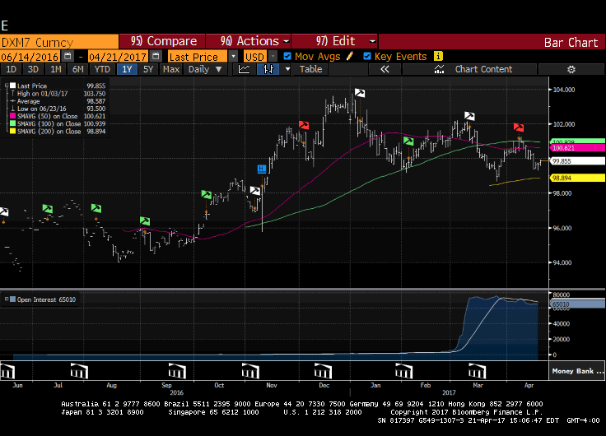

Slide 7
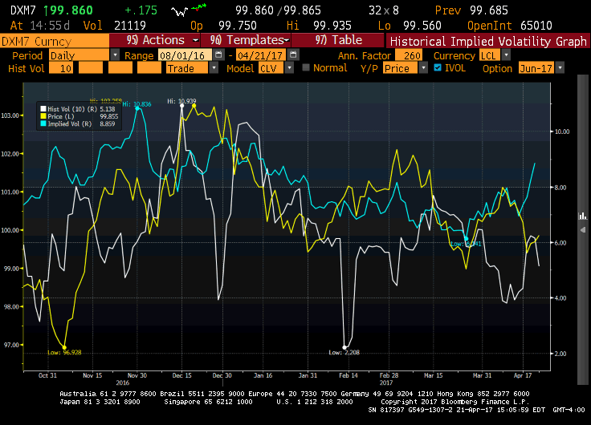

Slide 8
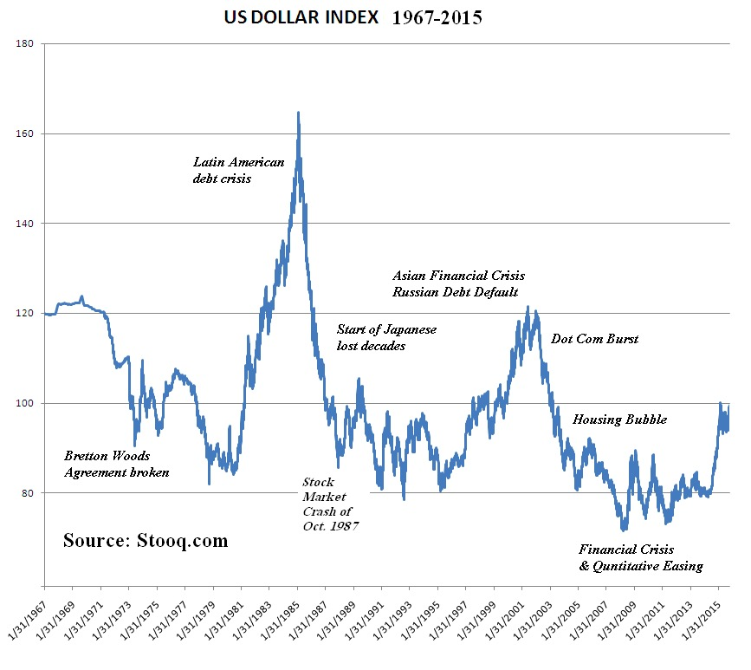
Major Events
Further Event:
2017 Trump Inauguration
Dollar retreats on Trump’s concern over currency’s strength
Notes:
2008 Financial Crisis
The great market upheaval of 2008 has stripped 45 percent from the value of global equities, led bank lending to nearly dry up and caused commodity prices to crash from stratospheric heights. Paradoxically, it is helping to lift the long-suffering dollar. The U.S. currency has been on rampage of late, gaining 15.5 percent against a basket of currencies since Aug. 1. As stock markets sank again Wednesday, the dollar rose against its European counterparts.
2017 Trump Inauguration The dollar retreated from the high it struck at the start of the year after Donald Trump signalled his preference for a weaker currency by warning that the greenback was “too strong” for US companies to compete with their Chinese counterparts.

Slide 9
TY Market Description
A Treasury bond (T-Bond) is：
“A marketable, fixed-interest U.S. government debt security with a maturity of more than 10 years. Treasury bonds make interest payments semi-annually, and the income received is only taxed at the federal level.
“Treasury bonds are known in the market as primarily risk-free; they are issued by the U.S. government with very little risk of default.”
Source: Wikipedia
Notes:
Insert Company Logo

Slide 10
TY Basic Information
Contract Value | $124,906.25
Trading Hours | Sunday - Friday 6:00 p.m. - 5:00 p.m. New York time/ET (5:00 p.m. - 4:00 p.m. Chicago Time/CT). Monday - Thursday 5:00 p.m. - 6:00 p.m. New York Time/ET (4:00 p.m. - 5:00 p.m. Chicago Time/CT) daily maintenance period.
Listed Contracts | The first three consecutive contracts in the March, June, September, and December quarterly cycle.
Settlement Method | Deliverable
Delivery Procedure | Federal Reserve book-entry wire-transfer system.
Termination Of Trading | Seventh business day preceding the last business day of the delivery month. Trading in expiring contracts closes at 12:01 p.m. on the last trading day.
Notes:
Insert Company Logo

Slide 11
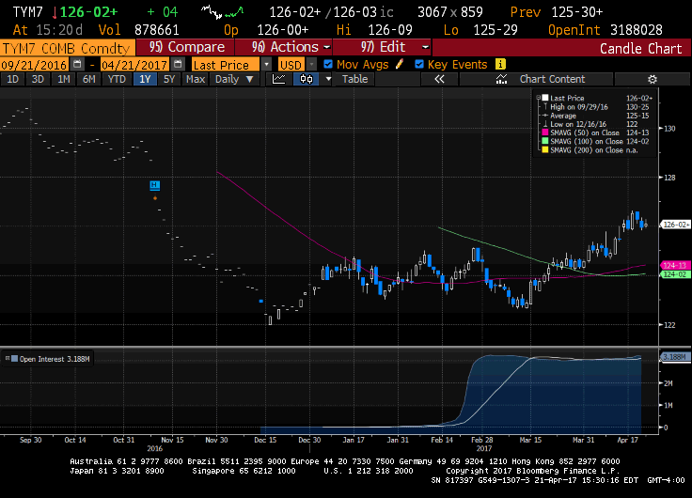

Slide 12
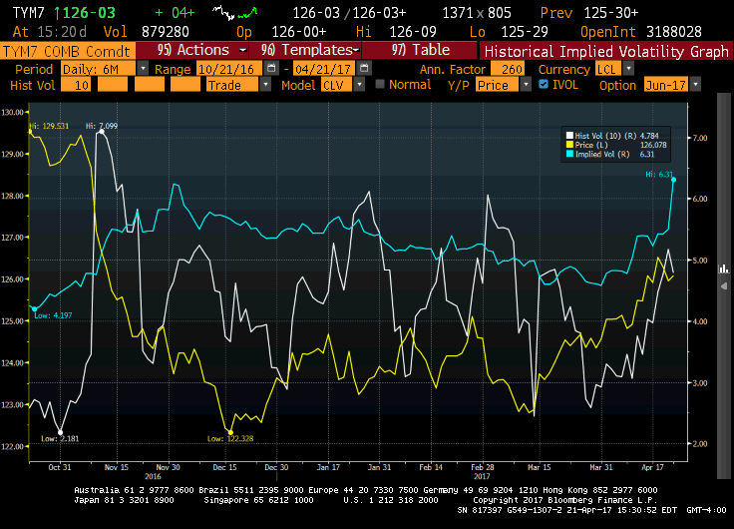

Slide 13
Major Events Impacting TY Prices
1973 Oil Crisis
“In 1973, Middle Eastern states placed an embargo on oil trade, in response to the US involvement in Israel’s Yom Kippur War. Unable to trade one of the most important commodities, economies went into crisis.
1997 Asian Financial Crisis
“Financial contagion in 1997 led to fears of an economic meltdown in Asia, which could have in turn led to a worldwide economic meltdown. The crisis Started in Thailand, with an accumulation of foreign debt, leading Thailand almost to bankruptcy.
2008 Financial Crisis
“During the financial crisis, investors began to avoid risky assets in favor of ultra-safe U.S. Treasury securities. Market investors were selling risky assets, they were rushing to the safety of U.S. Treasury securities.
2017 Presidency of Trump
“Treasuries had been largely selling off dramatically since Trump won the U.S. presidency, as investors anticipated more government spending, lower corporate taxes and deregulation of certain sectors.”
Source: Money Transfer Companion
Notes:
2008 financial crisis: Market investors were selling risky assets, they were rushing to the safety of U.S. Treasury securities.
During the credit crisis, the yield on the two-year Treasury bonds fell from more than 5% to less than 1%. Yields on shorter term Treasuries declined even further, and at one point the yield on some securities was actually negative. In other words, investors had so little confidence in the financial system that they were willing to pay the Treasury to hold their money, as opposed to investing it elsewhere and attempting to earn a reasonable rate of return.

Slide 14
Statistical Tests
Notes:
Insert Company Logo

Slide 15
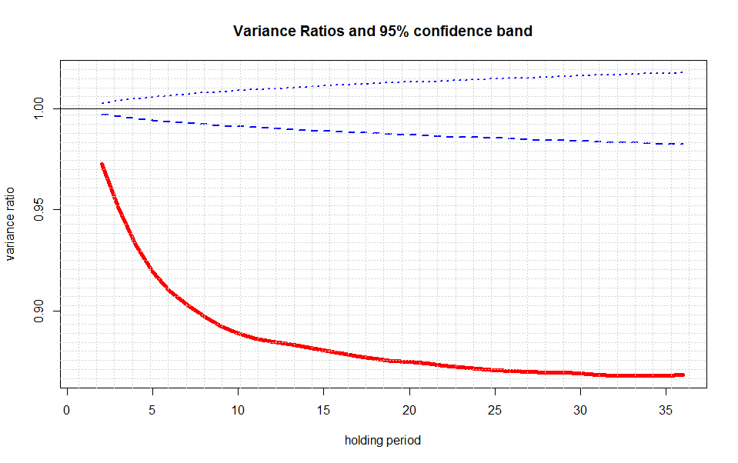
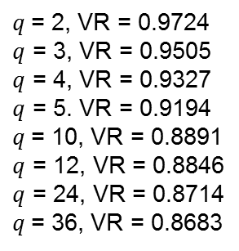
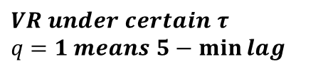
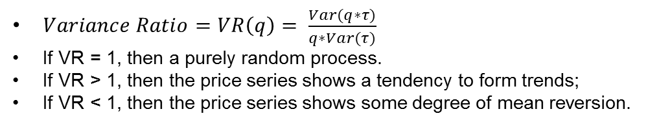
Statistical Tests – Variance Ratio
Data: DX-5min, Log return
$$VR under certain τ$$
$q$ $=1 means 5−\min{lag}$
$q$= 2, VR = 0.9724
$q$ = 3, VR = 0.9505
$q$ = 4, VR = 0.9327
$q$ = 5. VR = 0.9194
$q$= 10, VR = 0.8891
$q$ = 12, VR = 0.8846
$q$ = 24, VR = 0.8714
$q$= 36, VR = 0.8683
If the underlying asset is US dollars, the short-term trend following is not as significant as what it is under 10-year treasury bonds. However, we may use other statistical tests.
$Variance Ratio=VR\left(q\right)= \frac{Var(q∗τ)}{q∗Var(τ)}$
If VR = 1, then a purely random process.
If VR > 1, then the price series shows a tendency to form trends;
If VR < 1, then the price series shows some degree of mean reversion.
Notes:
Insert Company Logo

Slide 16
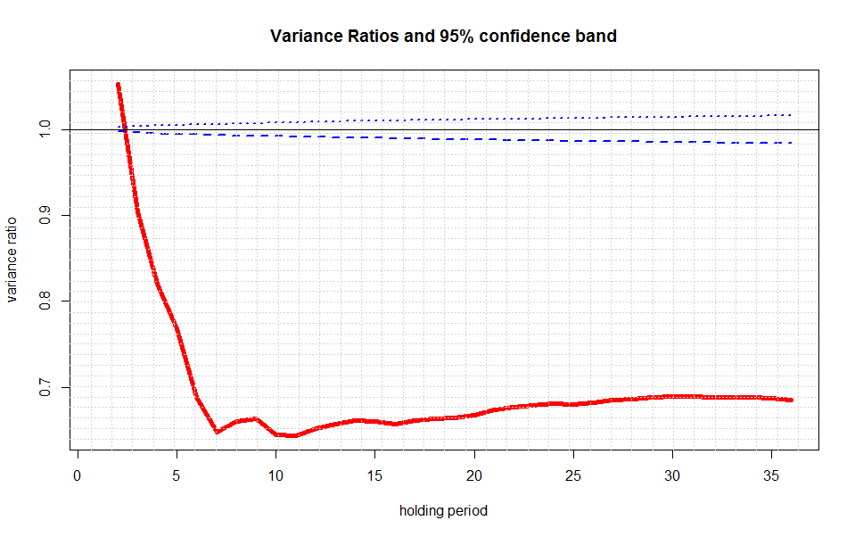
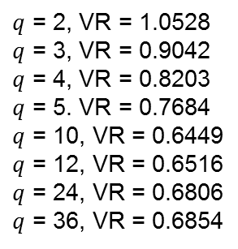
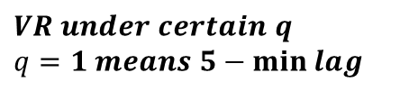
Statistical Tests – Variance Ratio
Data: TY-5min, Log return
$$VR under certain q$$
$q$ $=1 means 5−\min{lag}$
$q$ = 2, VR = 1.0528
$q$ = 3, VR = 0.9042
$q$ = 4, VR = 0.8203
$q$ = 5. VR = 0.7684
$q$ = 10, VR = 0.6449
$q$ = 12, VR = 0.6516
$q$ = 24, VR = 0.6806
$q$ = 36, VR = 0.6854
As can be seen, if the underlying asset is the US 10-year treasury bonds, there is a trend following for a super-short term (<15 mins) with mean reversion for longer periods, this provides us with a reasonable basis to perform the trading algorithm.
Notes:
Insert Company Logo

Slide 17
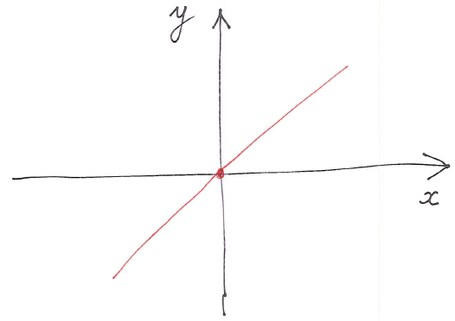
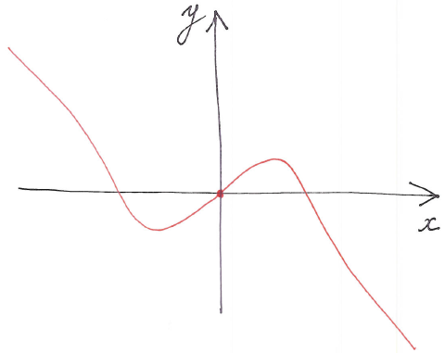
Statistical Tests – Push Response Function
Push Response Decomposition Overview
Mean-reversion
Trend-following
Short-term mean-reversion and long-term trend-following
Short-term trend-following and long-term mean-reversion
Notes:
Insert Company Logo

Slide 18
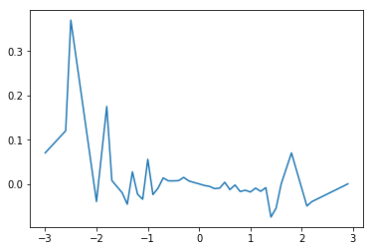
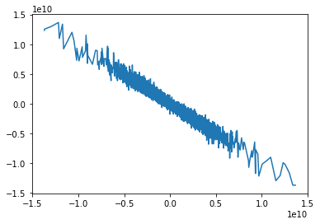
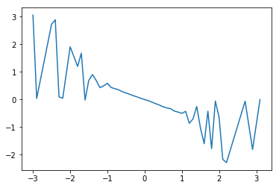



Statistical Tests – Push Response Function
Presentation of Push Response Diagrams
Data: DX-5min
$$τ=1 (5 mins)$$
$$τ=36 (3 hours)$$
$$τ=2 (10 mins)$$
If the underlying asset is US dollars, we can also observe a shot-term trend-following and long-term mean-reversion. Thus, the short-term trend-following is more significant in the push response diagram than the variance ratio test.
Notes:
Insert Company Logo

Slide 19
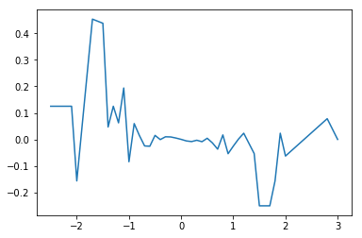
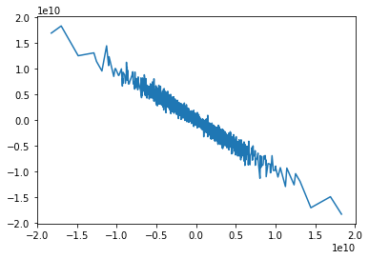
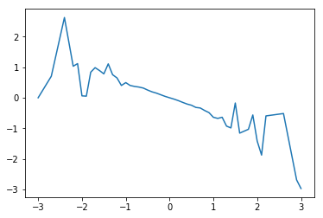
Statistical Tests – Push Response Function
Presentation of Push Response Diagrams
Data: TY-5min
$$τ=1 (5 mins)$$
$$τ=36 (3 hours)$$
$$τ=2 (10 mins)$$
If the underlying asset is 10-year US treasury bonds, we can observe a shot-term trend-following and long-term mean-reversion. This is consistent with the result of variance ratio test.
Notes:
Insert Company Logo

Slide 20
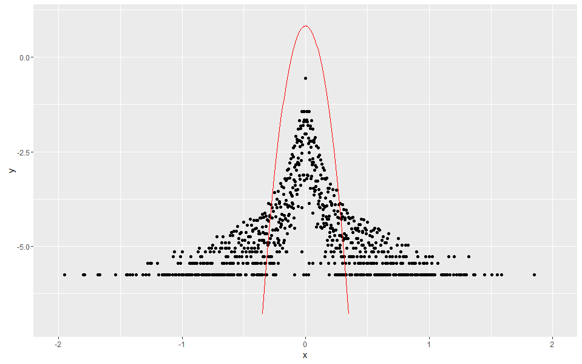
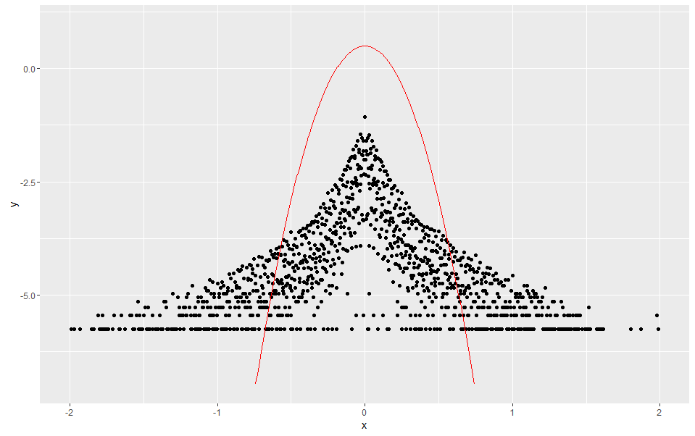
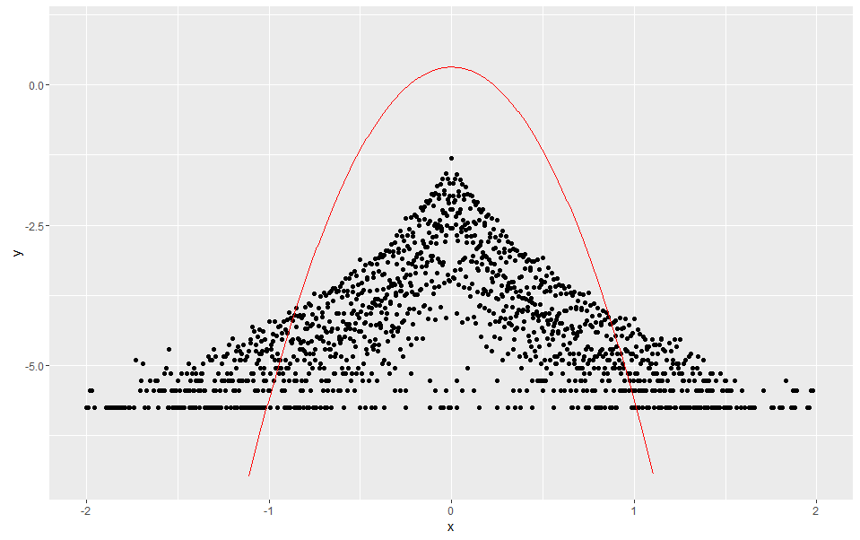
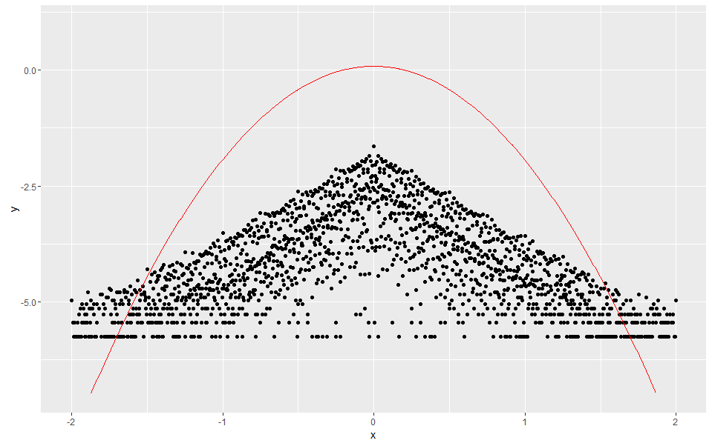


Statistical Tests – Price Anomalies
Presentation of Non-Gaussian “Fat” Tails in PDF
Data: DX-5min
$$τ=1 (5 mins)$$
$$τ=6 (30 mins)$$
$$τ=12 (1 hour)$$
$$τ=36 (3 hours)$$
Notes:
Insert Company Logo

Slide 21
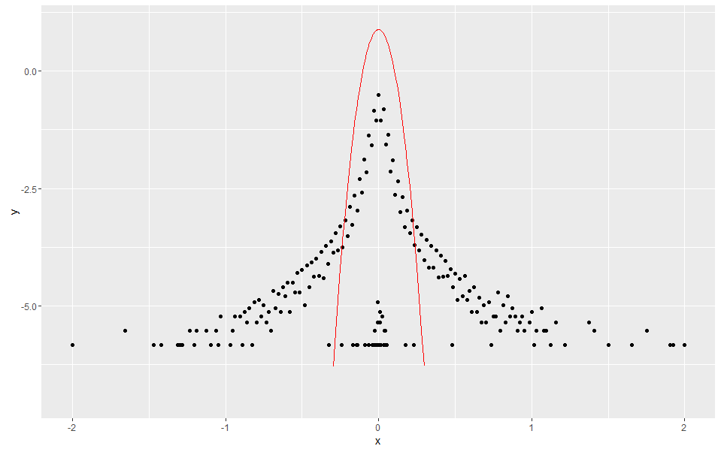
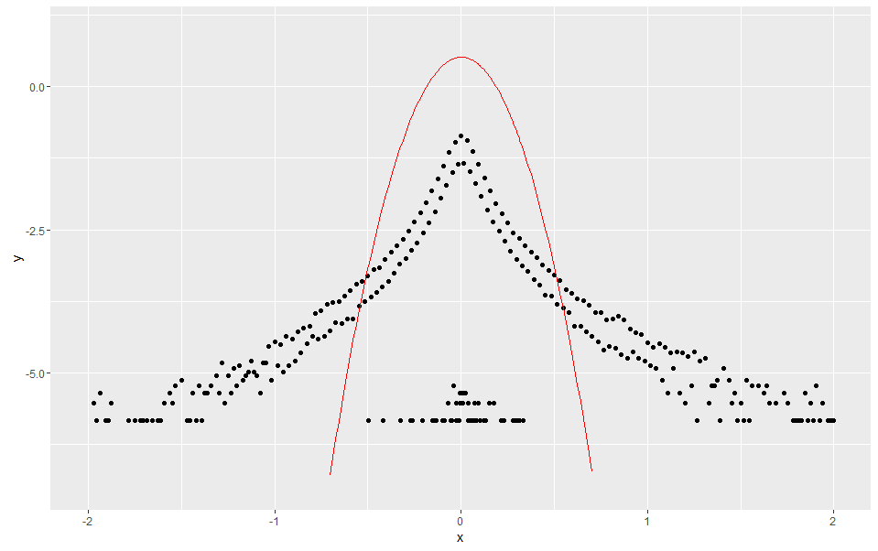
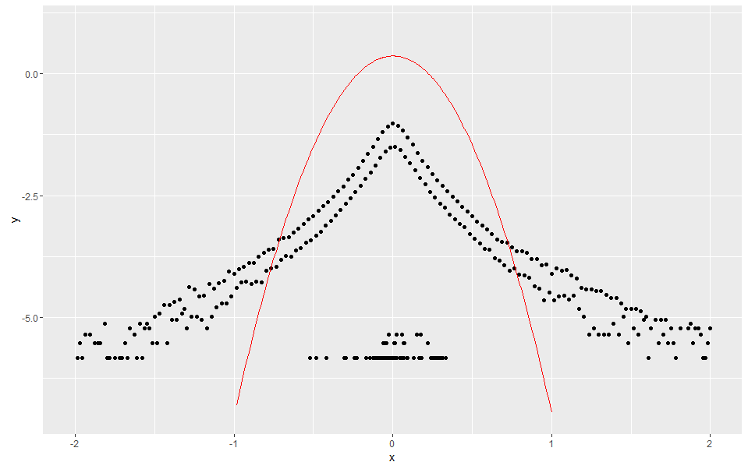
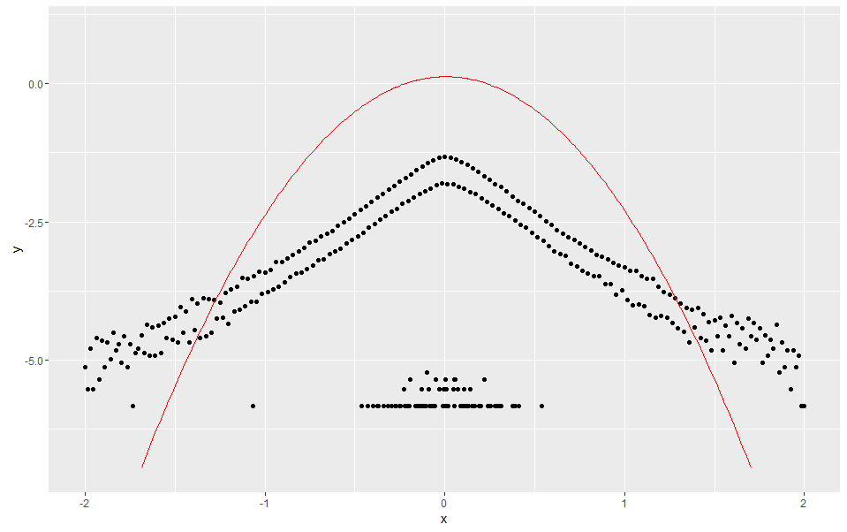
Statistical Tests – Price Anomalies
Presentation of Non-Gaussian “Fat” Tails in PDF
Data: TY-5min
$$τ=1 (5 mins)$$
$$τ=6 (30 mins)$$
$$τ=12 (1 hour)$$
$$τ=36 (3 hours)$$
Notes:
Insert Company Logo

Slide 22
Trading Algorithm
Notes:
Insert Company Logo

Slide 23
Trading Algorithm
Logic Behind Algorithm
Step 1: Setting initial variables
Key variables presentation:
Channel length: user’s choice of the length of channel (e.g. step = 5 mins if channel length = 100)
StpPct: user’s choice of stopping percentage (used to determine the price to exit a trade)
Market position: = 1 for a long position; = -1 for a short position; = 0 if no position/stay
PrevPeak/PrevThrough: the peak/trough of the previous channel
HH/LL: highest of high prices/lowest of low prices for the selected channel
High/Low/Open/Close: given prices of the underlying asset
Buy/Short: to record total amounts of buy and short trades
Other variables include a recorder of the amount of cash on hand, a recorder of cumulative equity for each channel and a timer used to test the code efficiency.
Notes:
Insert Company Logo

Slide 24
Trading Algorithm
Logic Behind Algorithm
Step 2-1: Entry to a long position (buy a new asset)
Market position = 0?
Yes
No
Next bar’s Open >= HH?
Don’t enter into the market
Yes
No
Entry price = Open
Market position = 1
PrevPeak = Open
Buy = Buy + 1
Current = Current – Open – (slippage/2)
* Current records the amount of cash on hand
Next bar’s High >= HH?
Yes
No
Entry price = HH
Market position = 1
PrevPeak = HH
Buy = Buy + 1
Current = Current – HH– (slippage/2)
* Current records the amount of cash on hand
Stay, don’t enter into the market
Notes:
Insert Company Logo

Slide 25
Trading Algorithm
Logic Behind Algorithm
Step 2-2: Entry to a short position (borrow and sell an asset)
Market position = 0?
Yes
No
Next bar’s Open <= LL?
Don’t enter into the market
Yes
No
Entry price = open
Market position = -1
PrevTrough = Open
Sell = Sell + 1
Current = Current + Open – (slippage/2)
* Current records the amount of cash on hand
Next bar’s Low < LL?
Yes
No
Entry price = LL
Market position = -1
PrevTrough = LL
Sell = Sell + 1
Current = Current + LL– (slippage/2)
* Current records the amount of cash on hand
Stay, don’t enter into the market
Notes:
Insert Company Logo

Slide 26
Trading Algorithm
Logic Behind Algorithm
Step 3-1: Exit/close a long position (stop the existing position)
Market position = 1?
Yes
No
Next bar’s Close > PrevPeak?
Don’t exit the trade
Yes
PrevPeak = close
No
Next bar’s Open <= target?
** target = PrevPeak * (1 – StpPct)
Yes
No
Close price = Open
Market position = 0
Current = Current + Open – (slippage/2)
* Current records the amount of cash on hand
Next bar’s Low <= target?
Yes
No
Close price = target
Market position = 0
Current = Current + Close – (slippage/2)
* Current records the amount of cash on hand
Stay, don’t exit the trade
Notes:
Insert Company Logo

Slide 27
Trading Algorithm
Logic Behind Algorithm
Step 3-2: Exit/close a short position (stop the existing position)
Market position = -1?
Yes
No
Next bar’s Close < PrevTrough?
Don’t exit the trade
Yes
PrevTrough = Close
No
Next bar’s Open >= target?
** target = PrevTrough * (1 + StpPct)
Yes
No
Close price = Open
Market position = 0
Current = Current – Open – (slippage/2)
* Current records the amount of cash on hand
Next bar’s High >= target?
Yes
No
Close price = target
Market position = 0
Current = Current – Close – (slippage/2)
* Current records the amount of cash on hand
Stay, don’t exit the trade
Notes:
Insert Company Logo

Slide 28
RoA Optimization Algorithms
Notes:
Insert Company Logo

Slide 29
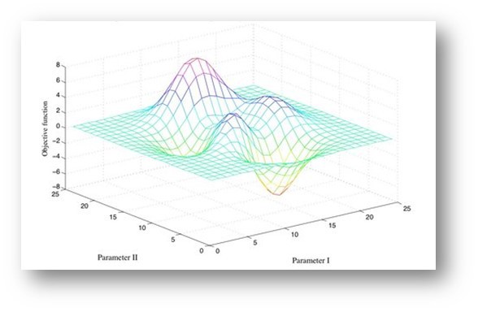
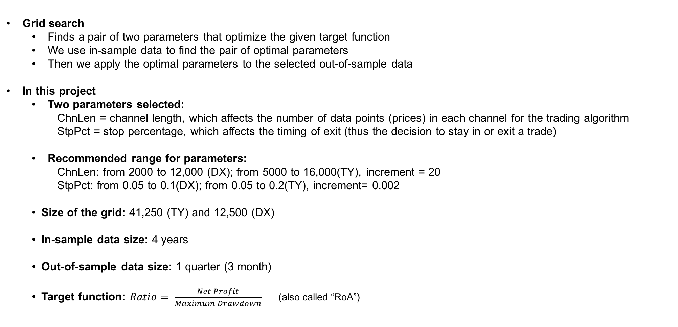
Two-Parameter Optimization Algorithm
Grid search
Finds a pair of two parameters that optimize the given target function
We use in-sample data to find the pair of optimal parameters
Then we apply the optimal parameters to the selected out-of-sample data
In this project
Two parameters selected:
ChnLen = channel length, which affects the number of data points (prices) in each channel for the trading algorithm
StpPct = stop percentage, which affects the timing of exit (thus the decision to stay in or exit a trade)
Recommended range for parameters:
ChnLen: from 2000 to 12,000 (DX); from 5000 to 16,000(TY), increment = 20
StpPct: from 0.05 to 0.1(DX); from 0.05 to 0.2(TY), increment= 0.002
Size of the grid: 41,250 (TY) and 12,500 (DX)
In-sample data size: 4 years
Out-of-sample data size: 1 quarter (3 month)
Target function: $Ratio= \frac{Net Profit}{Maximum Drawdown}$ (also called “RoA”)
Notes:
Insert Company Logo

Slide 30
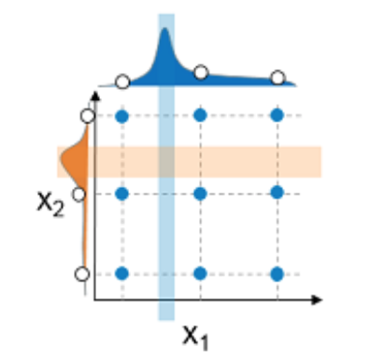
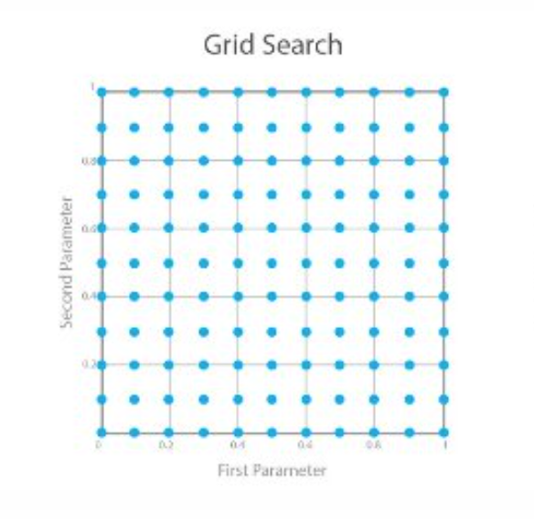
Grid Search involves setting up a grid with one parameter on each axis, evaluating the target function at each grid point, and finding the grid point corresponding to the maximum RoA.
Grid Search
Use DX and TY 5-min price data
Calculate target function at all grid points
First parameter is ChnLen, second is StpPct
Notes:
Insert Company Logo

Slide 31
We used grid search and simulated annealing in our project.
Comparison of Optimization Methods
Grid Search
Finds global maximum RoA but is slow
Simulated Annealing
Relatively easy to code even for a complex problem
Evaluates every possible solution
Heuristic method: Not guaranteed to find global maximum but takes less time than grid search
Notes:
Insert Company Logo

Slide 32
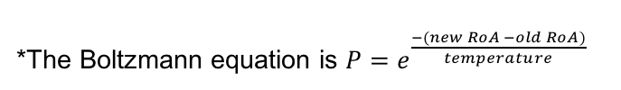
Simulated Annealing is a heuristic technique for finding an approximately optimal solution. It is similar to a hill-climbing optimization, but stochastically generates random neighboring solutions, and sometimes chooses (with a small probability) not to move toward a better solution. It does this in order to avoid being stuck in a local maximum.
Simulated Annealing
Randomly generate ChnLen and StpPct
Calculate RoA of random solution
*The Boltzmann equation is $P=e^{\frac{−(new RoA −old RoA)}{temperature}}$
Randomly generate neighboring (“new”) solution
Calculate RoA of new solution
Compare old RoA with new RoA
Reduce temperature (decrement iteration counter)
If new RoA is better than old RoA, keep the new RoA
Else, use Boltzmann equation* to probabilistically decide whether to keep the worse solution
Notes:
”Temperature” and “annealing” analogy to metallurgy

Slide 33
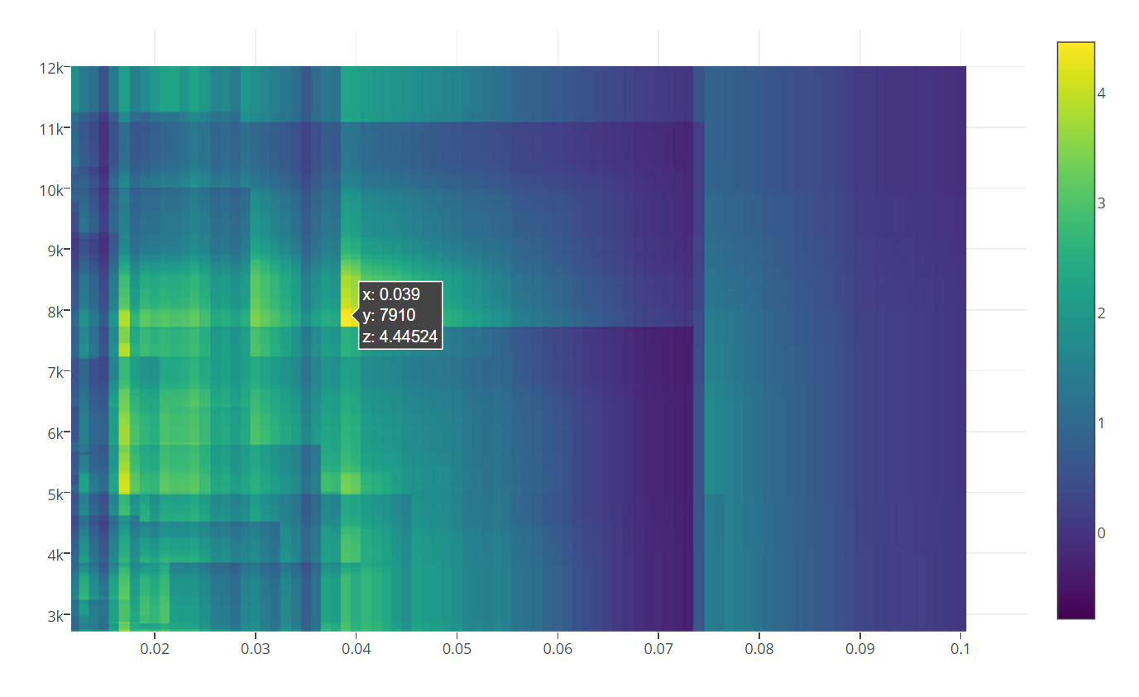
DX Market Heat Map
Heat Map Of DX Market (The first 4-yr window)
Grid Search Result:
StpPct = 0.039
ChnLen = 7920
RoA = 4.44524
Notes:
Adding the Heat Map

Slide 34
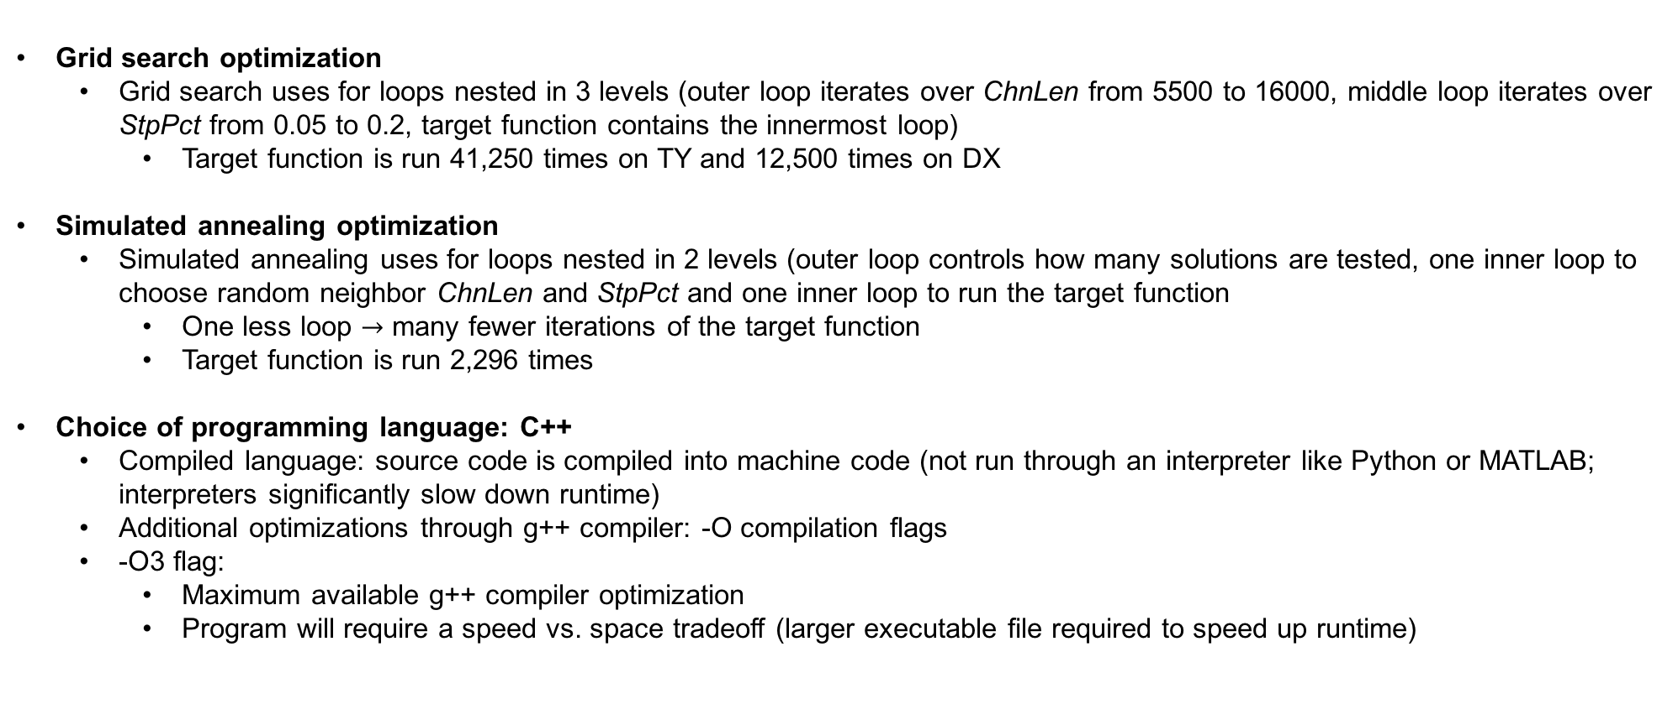
Code Efficiency
Grid search optimization
Grid search uses for loops nested in 3 levels (outer loop iterates over ChnLen from 5500 to 16000, middle loop iterates over StpPct from 0.05 to 0.2, target function contains the innermost loop)
Target function is run 41,250 times on TY and 12,500 times on DX
Simulated annealing optimization
Simulated annealing uses for loops nested in 2 levels (outer loop controls how many solutions are tested, one inner loop to choose random neighbor ChnLen and StpPct and one inner loop to run the target function
One less loop $→$ many fewer iterations of the target function
Target function is run 2,296 times
Choice of programming language: C++
Compiled language: source code is compiled into machine code (not run through an interpreter like Python or MATLAB; interpreters significantly slow down runtime)
Additional optimizations through g++ compiler: -O compilation flags
-O3 flag:
Maximum available g++ compiler optimization
Program will require a speed vs. space tradeoff (larger executable file required to speed up runtime)
Notes:
Insert Company Logo

Slide 35
Final Analysis
Notes:
Insert Company Logo

Slide 36
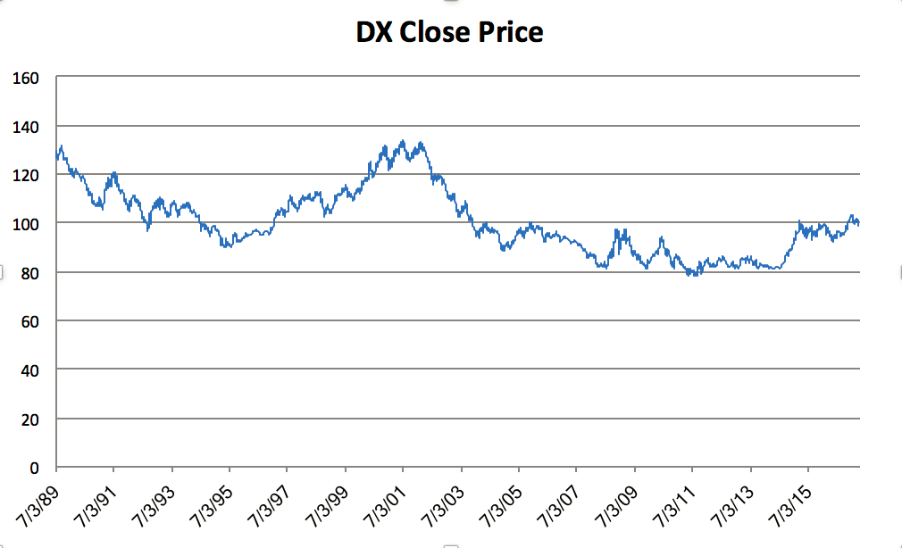
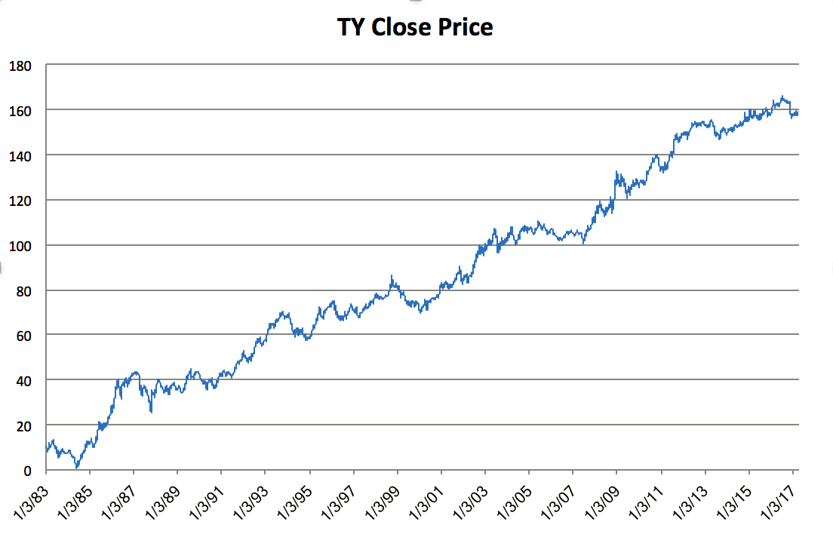
Graphs from Original Data Set
DX Close Price Graph
TY Close Price Graph
Notes:
Before we introduce our result of apply trend-following trading strategy, I would like to first show you the graph of original data set. Here, TY markets, shown in the graph that itself has a super long upward trend. Remember when we did the statistical testing, we found that the TY market has some 5min to 15 min short-term trend following property and like 3 hour long term mean reversion property. But here, the time frame that we use for statistical testing is too short and actually can not reflect this overall trend of Treasury market. In order to catch this trend, we adjust our T used in the strategy and also change our searching range for channel length to ‘5000-16000’. We also improve the search range of stppct to ‘0.05-0.2’, just to avoid it stuck in some small oscillations and missed the overall upward trend.

Slide 37
Output Table of ChnLen, StpPct and RoA – DX Market
In sample - Avg ChnLen, StpPct, and RoA with respect to different T and Tau
DX | ChnLen |  |  | StpPct |  |  | RoA
Tau\T | 2 | 4 | 10 | 2 | 4 | 10 | 2 | 4 | 10
1 | 5325.146 | 3576.421 | 4468.31 | 0.020922 | 0.019811 | 0.023648 | 2.761984 | 3.72114 | 3.987027
2 | 5147.255 | 5252.766 | 4635.71 | 0.023569 | 0.020021 | 0.024543 | 2.7192 | 3.42194 | 4.082924
4 | 4842 | 5077.391 | 4976.471 | 0.02696 | 0.018174 | 0.025941 | 2.924409 | 3.566161 | 4.112866
Notes:
Adding the output of ChnLen & StpPct 1) for DX
First we check the output of our DX market using the grid search optimization method. As we stated before, our program runs relatively fast, for each set of T and tau, using T as in-sample window and tau as out-of-sample test window, we can rolling through the whole sample within one hour, so we tested 9 combination of different T and tau to do the comparison. As we run over the full sample, the table here shows the average parameters & RoA from grid search of each combination of T & tau. From the table we can see that we get best ROA for longer T (How to explain???) We think that is just because for longer T, we have more time in one optimization, which gives to that more probability to have a good in sample optimization. But be cautious, this is only for in sample. In sample optimization does not mean out of sample and thus it is kind of risky in overfitting.(I don’t know saying like that whether approperiate, but I think too long in sample optimization is not so robust.)

Slide 38
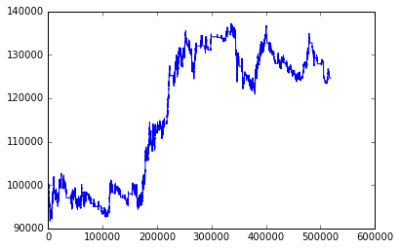
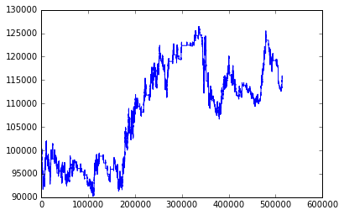
DX Market - Graphs from Grid Search
T=2
T=2 Tau=1
T=2
Tau=2
Notes:
Get the grid search result, we run the out-of-sample test. Here we go through the equity curve(???) of the out-of-sample test of different T & tau combinations

Slide 39
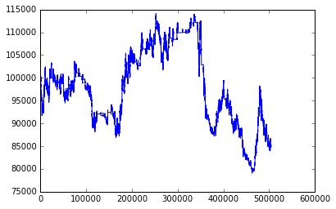
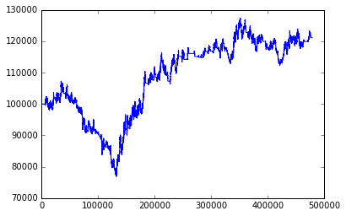
DX Market - Graphs from Grid Search
T=2
T=4
T=2 Tau=4
T=4
Tau=1
Notes:
Insert Company Logo

Slide 40
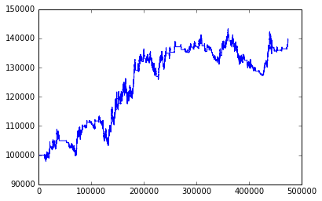
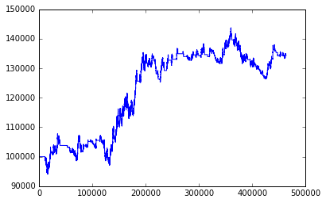
DX Market - Graphs from Grid Search
T=4
T=4 Tau=2
T=4
Tau=4
Notes:
Insert Company Logo

Slide 41
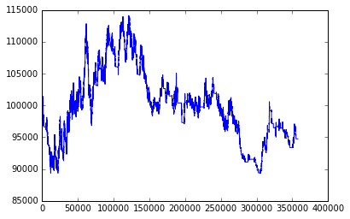
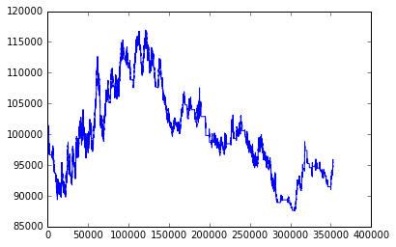
DX Market - Graphs from Grid Search
T=10
T=10 Tau=1
T=10
Tau=2
Notes:
Insert Company Logo

Slide 42
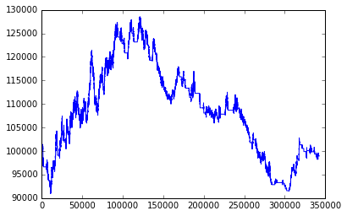
DX Market - Graphs from Grid Search
T=10
T=10 Tau=4
Notes:
Insert Company Logo

Slide 43
DX Market - Graphs from Grid Search
Best Performer
T=4 Tau=2
Notes:
When T = 4, tau =2, we got the best performer. We can see it gives us about 4000 profit.

Slide 44
DX Market - Comparison
tau/T | ROA |  |  | MAX dd |  |  |  | Buy, Sell
DX | 2 | 4 | 10 |  | 2 | 4 | 10 |  | 2 | 4 | 10
1 | 1.513016867 | 0.694300925 | -0.21151979 | 1 | 16278.11 | 30431.43 | 24800.28 | 1 | (128,132) | (156,180) | (73,74)
2 | 0.779124363 | 2.446839533 | -0.15845328 | 2 | 19755.325 | 16014.72 | 29399.05 | 2 | (112,118) | (106,113) | (66,63)
4 | -0.429138139 | 1.983441741 | -0.02803673 | 4 | 35039.335 | 17334.25 | 37038.56 | 4 | (106,119) | (114,110) | (59,55)
Notes:
This table shows a more clear result of our out-of-sample test for different T & tau. The best performer, where T=4, tau=2, gives us a RoA of about 2.45 and Maxmium drawdown is about 16014.72. We have about 200 trades for DX in total, (How to explain????) That is because we use a relatively small channel-length and stop percentage for DX data, we first observe the data and seems it is volatile in small period, so we want to catch these small volatility or trend.

Slide 45
Output Table of ChnLen, StpPct and RoA – TY Market
In sample - Avg ChnLen, StpPct, and RoA with respect to different T and Tau
TY | ChnLen |  |  | StpPct |  |  | RoA
Tau\T | 2 | 4 | 10 | 2 | 4 | 10 | 2 | 4 | 10
1 | 10120.92 | 11034.29 | 10375.41 | 0.138553 | 0.1125 | 0.093266 | 1.237073 | 1.9493 | 3.658643
2 | 10034.57 | 9963.03 | 10298.89 | 0.0131086 | 0.112909 | 0.094741 | 1.257717 | 1.952157 | 3.647047
4 | 11164.57 | 10764.24 | 10682.96 | 0.1416 | 0.113091 | 0.095259 | 1.364325 | 1.946929 | 3.654741
Notes:
Next, we check the grid search result for TY market. Again, here is the in sample optimization result we got for each T & tau combination, as we rolling through the whole sample, we put the average value here in the table. For TY, it is quite obvious that when T is large (=10) the optimized ROA is significantly larger than the case T=2, T=4. As we mentioned before, the TY market itself has a overall upward trend with oscillations in short term, so using large optimize window would help us to catch this overall trend.

Slide 46
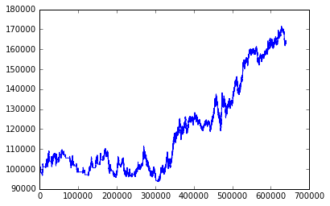
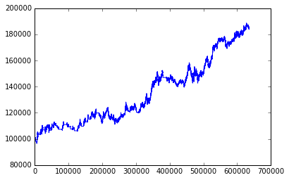
TY Market - Graphs from Grid Search
T=2
T=2 Tau=1
T=2
Tau=2
Notes:
Also, getting the in sample grid search result, we did the out-of-sample backtesting. Here are the equity curves (???) for different T & tau combination.

Slide 47
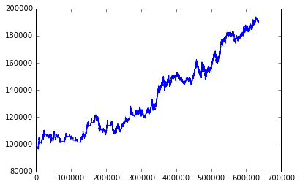
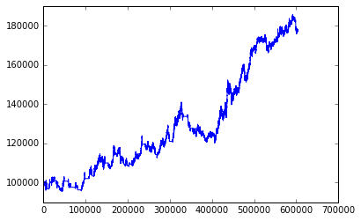
TY Market - Graphs from Grid Search
T=2
T=4
T=2 Tau=4
T=4
Tau=1

Slide 48


TY Market - Graphs from Grid Search
T=4
T=4 Tau=2
T=4
Tau=4

Slide 49


TY Grid Search Graphs
T=10
T=10 Tau=1
T=10
Tau=2

Slide 50

TY Grid Search Graphs
T=10
T=10 Tau=4

Slide 51
TY Grid Search Graphs
Best Performer
T=2 Tau=4
Notes:
Our best out-of-sample performer it’s actually when T=2, tau=4. (Contradicts with the in-sample result??? As we know that using grid search it always tends to give the best in-sample result, but maybe bad out-of-sample result.) ??
out-of-sample’s kind of random

Slide 52
TY Market - Comparison
tau/T | ROA |  |  | MAX dd |  |  |  | Buy, Sell
TY | 2 | 4 | 10 |  | 2 | 4 | 10 |  | 2 | 4 | 10
1 | 3.445814237 | 3.701297652 | 5.200616615 | 1 | 18362.46875 | 20881.46875 | 13845.75 | 1 | 29, 20 | 19, 31 | 14, 13
2 | 5.382521051 | 2.060636814 | 2.75888599 | 2 | 15598.40625 | 29745.75 | 21381.09 | 2 | 29, 19 | 22, 25 | 15, 13
4 | 6.109817143 | 2.121656456 | 2.771509466 | 4 | 14608.375 | 25870.75 | 23332.75 | 4 | 25, 11 | 23, 20 | 14, 11
Notes:
Using the table we checked the calculated RoA, MaxDD and trades for each combination. Aagin, best ROA comes from T=2, tau=4, but the case T=10, tau=1 also performs pretty well, and it has the minimum MaxDD. The trades in TY markets are less frequently than DX market. (How to explain???? )
Since in TY market, we can observe that not only small trends, it also shows big trends. Since we want to catch these big trends, we use a bigger channel-length and stop percentage to optimize. That is a reason why TY has fewer trades.
About the channel-length and stop percentage. One makes how much is the frequency to long or short, one makes how frequently the position be closed.

Slide 53
Grid Search vs Simulated Annealing
Comparison tables of Avg ChnLen, StpPct, and RoA when T=4, Tau=1 (In-Sample)
DX | Grid Search | Simulated Annealing
ChnLen | 3576.421 | 5720.947
StpPct | 0.019811 | 0.039986
RoA | 3.72114 | 1.342409
TY | Grid Search | Simulated Annealing
ChnLen | 10034.29 | 7991.84
StpPct | 0.1125 | 0.09938
RoA | 1.9493 | 1.191
Optimal
DX | Grid Search | Simulated Annealing
ChnLen | 9600 | 8205
StpPct | 0.006 | 0.091006
RoA | 6.574383 | 4.990256
TY | Grid Search | Simulated Annealing
ChnLen | 8700 | 8640
StpPct | 0.056 | 0.0501
RoA | 6.172999 | 6.187274
Notes:
Comparison table for Grid Search & Simulated Annealing
Besides the Grid Search method, we also tried Simulated Annealing method. As Sarah just mentioned, using grid search could help us get the global optimal point, but it is super time consuming as it search over the whole range. The Simulated Annealing will perform faster than grid search, but it may not give us the global optimal. Here we compare the in-sample optimization result and using the T & tau value that professor suggested. The first two tables are the average result. We can see that for DX, the average RoA of simulated annealing is significantly smaller than grid search, (??? Anything wrong with the DX simulated annealing???) and for TY market we can also see the comparison. Different markets need different iterations to make the results converge.
The next two table is the optimal in-sample RoA that we got from the two search. We can see for DX, the simulated annealing failed to get the global optimal, but for TY, the simulated annealing optimal is RoA actually a little higher than Grid Search. (This is because that when we do grid search we set the step for chnlen to be 20 and step for stppct to be 0.01, so literally it is not searching over the whole range but the result’s pretty close.)

Slide 54

Graph of Simulated Annealing Result - DX Market
Notes:
Here is the in-sample ROA comparison graph for DX market. It is more obvious from the graph that Grid search always find a better optimal point than simulated annealing when doing in-sample optimization.

Slide 55

Graph of Simulated Annealing Result - TY Market
Notes:
Here is the comparison graph for TY

Slide 56
Performance Table - DX
Net Equity | 139185.45 | Average Winner to Average Loser | -2.349181137
Net Profit | 39185.45 | Average Winner to Average Loser | 0.012638423
Net Profit to Worst Drawdown | 2.446839533 | Average Loser | -0.005379927
Gross Gain | 129892.475 | Profit Factor | 1.432000168
Gross Loss | 90707.025 | Percent Winners | 0.388127855
Win Bars | 137966 | Percent Losers | 0.611872146
Loss Bars | 77982 | Winners Losers Ratio | 0.634328358
Bars | 215948 | Average Drawdown | 6567.723192
Avg Bars in Win | 1632 | RoA | 2.446839533
Avg Bars in Lose | 581 | Sharpe Ratio | 0.309599804
Avg Bars in Trade | 986 | Worst Drawdown | 16014.72
Best Winner | 0.094227766 | Long | 106
Worst Loser | -0.027410771 | Short | 113
Best Winner to Worst Loser | -3.437618158 | Standard Deviation Annualized | 0.045444766
Notes:
performance table for DX
We choose the best out-of-sample performer of DX and TY and calculated their performance. Here we can see the RoA for DX market is about 2.45, and our Net profit is approaching 40000. shapre ratio about 0.31 (risk free 1%)

Slide 57
Performance Table - TY
Net Equity | 189254.50 | Average Winner to Average Loser | -3.081180234
Net Profit | 89254.50 | Average Winner | 0.053919851
Net Profit to Worst Drawdown | 6.109817143 | Average Loser | -0.017499739
Gross Gain | 89786.65625 | Profit Factor | 2.224704894
Gross Loss | 40358.90625 | Percent Winners | 0.428571429
Win Bars | 445892 | Percent Losers | 0.571428571
Loss Bars | 75048 | Winners Losers Ratio | 0.8
Bars | 520940 | Average Drawdown | 1993.453414
Avg Bars in Win | 27868 | RoA | 6.109817143
Avg Bars in Lose | 3752 | Sharpe Ratio | 0.386750306
Avg Bars in Trade | 14471 | Worst Drawdown | 14608.375
Best Winner | 0.303421912 | Long | 25
Worst Loser | -0.04831223 | Short | 11
Best Winner to Worst Loser | -6.280436864 | Standard Deviation Annualized | 0.04712701
Notes:
performance table for TY
And for TY, the Net profit is about 90000, and RoA is 6.2, sharpe ratio again it’s about 0.4 (Similar to DX???) We have less trade for TY because it already have a overall upward trend, and we adjusted the params to catch this trend, so it make sense that it isn’t trade frequently. Actually, we might gain more if we just simply holding the TY from the beginning to the end. (but here’s the result that we applied the strategy lol)

Slide 58
Sample Trade Table - DX
Overall trade (Long 106 Short 113)
Here we just show the sample of first few trades
Position | Price | Date | Time
Buy | 108.16 | 12/30/87 | 11:40
Close | 106.6555 | 2/2/88 | 11:50
Sell | 106.08 | 2/22/88 | 13:10
Close | 105.16797 | 4/13/88 | 13:45
Sell | 103.31 | 5/10/88 | 11:05
Close | 103.5306 | 5/19/88 | 8:55
Sell | 102.17 | 6/29/88 | 10:10
Close | 99.5 | 7/15/88 | 8:05
Sell | 99.36 | 7/15/88 | 9:15
Close | 98.58776 | 8/9/88 | 8:20
Sell | 97.19 | 10/13/88 | 11:25
Close | 96.3824 | 12/6/88 | 8:05
Buy | 97.94 | 12/16/88 | 7:40
Close | 97.37134 | 1/27/89 | 12:05
Sell | 97.3 | 2/14/89 | 9:45
Close | 93.03352 | 4/7/89 | 12:20
Notes:
Trade Table for DX
We also made some trade table for DX & TY from out-of-sample test. Actually we have 106 long trade and 113 short trade and we only picked a small part to show here.

Slide 59
Sample Trade Table - TY
Overall trade (Long 25 Short 11)
Here we just show the sample of first few trades
Position | Price | Date | Time
Buy | 13.1875 | 1/23/85 | 8:05
Close | 11.3125 | 02/21/85 | 8:05
Buy | 14.3125 | 4/18/85 | 8:05
Close | 17.40625 | 7/26/85 | 8:05
Buy | 22.1875 | 10/30/85 | 8:05
Close | 26.8125 | 1/9/86 | 8:05
Buy | 29.03125 | 2/4/86 | 8:05
Close | 27.09375 | 2/7/86 | 8:05
Buy | 29.25 | 2/13/86 | 8:05
Close | 33.83175 | 2/28/86 | 12:05
Buy | 35.8125 | 3/4/86 | 8:05
Close | 34.216875 | 3/5/86 | 11:55
Buy | 36.125 | 3/10/86 | 10:10
Close | 40.21875 | 4/16/86 | 8:05
Buy | 38.80875 | 4/22/86 | 13:10
Close | 40.96875 | 8/20/86 | 8:05
Notes:
Trade Table for TY
And here ‘s the out-of-sample trade table for TY. You can see our buyin points and close points here. For TY, we did more long trade.

Slide 60
References
https://www.csie.ntu.edu.tw/~cjlin/talks/rome.pdf
http://katrinaeg.com/simulated-annealing.html
http://stockcharts.com/school/doku.php?id=chart_school:technical_indicators:price_channels
http://www.investopedia.com/terms/d/drawdown.asp
http://www.investopedia.com/terms/p/position.asp
http://www.investopedia.com/terms/t/trailingstop.asp
https://ocw.mit.edu/courses/engineering-systems-division/esd-77-multidisciplinary-system-design-optimization-spring-2010/lecture-notes/MITESD_77S10_lec10.pdf
https://gcc.gnu.org/onlinedocs/gcc/Optimize-Options.html
http://machinelearningmastery.com/gradient-descent-for-machine-learning/
https://www.quora.com/What-is-an-intuitive-explanation-of-gradient-descent
https://www.quora.com/What-are-the-potential-downsides-of-the-gradient-descent-method
http://moneytransfercomparison.com/major-economical-events-which-impacted-currency-rates/
https://www.theice.com/products/194/US-Dollar-Index-Futures
http://www.cmegroup.com/trading/interest-rates/us-treasury/10-year-us-treasury-note_contract_specifications.html
http://www.reuters.com/article/us-global-forex-idUSKBN15314533
https://www.ft.com/content/b921b994-dca3-11e6-9d7c-be108f1c1dce
Notes:
Insert Company Logo

Slide 61
Q&A

